Slide 1


Slide 2




What’s new in ASP.NET Core 2.0
Scott Addie
Senior Content Developer
@Scott_Addie

Slide 3


Build with Microsoft Tech
Explore developer tools, platforms, and APIs
docs.microsoft.com

Slide 4
What’s new in ASP.NET Core 2.0
Scott Addie
Senior Content Developer
@Scott_Addie

Slide 5
Agenda
Publish size reduction
View compilation changes
Metapackage
Runtime store
Configuration simplification
Project templates
Razor Pages

Slide 6

Publish size reduction
v1.1
16.8 MB
26.7 MB
w/ Identity
v2.0
2.63 MB
3.09 MB
w/ Identity
File → New → Project…
Notes:
1.x is the “donut of ASP.NET Core”
Release mode, FDD publish, PublishOutput folder
2 factors: View Compilation & Runtime Store

Slide 7
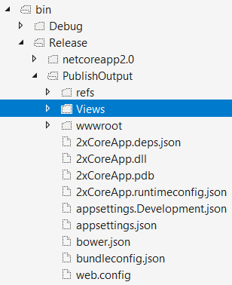
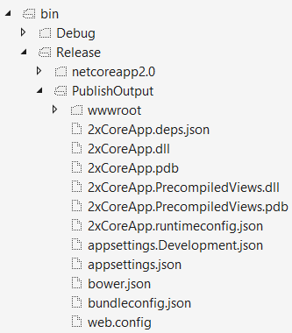
View compilation
2xCoreApp.csproj
<Project Sdk="Microsoft.NET.Sdk.Web"> <PropertyGroup> <TargetFramework>netcoreapp2.0</TargetFramework> <MvcRazorCompileOnPublish>false</MvcRazorCompileOnPublish> </PropertyGroup>
2xCoreApp.csproj
<Project Sdk="Microsoft.NET.Sdk.Web"> <PropertyGroup> <TargetFramework>netcoreapp2.0</TargetFramework> </PropertyGroup>
Notes:
On by default

Slide 8
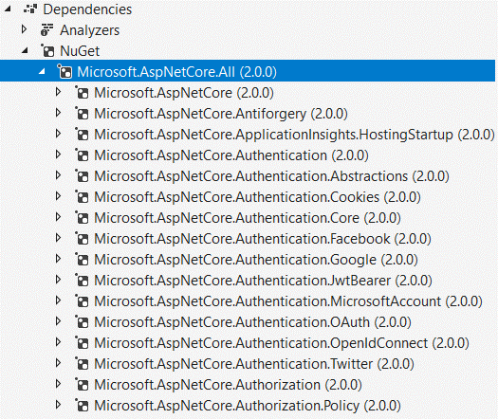
Metapackage
2xCoreApp.csproj
<ItemGroup> <PackageReference Include="Microsoft.AspNetCore.All" Version="2.0.0" /> </ItemGroup>
Notes:
.NET Core 2.0 only (no .NET Fx support)
Package version aligns w/ product version

Slide 9


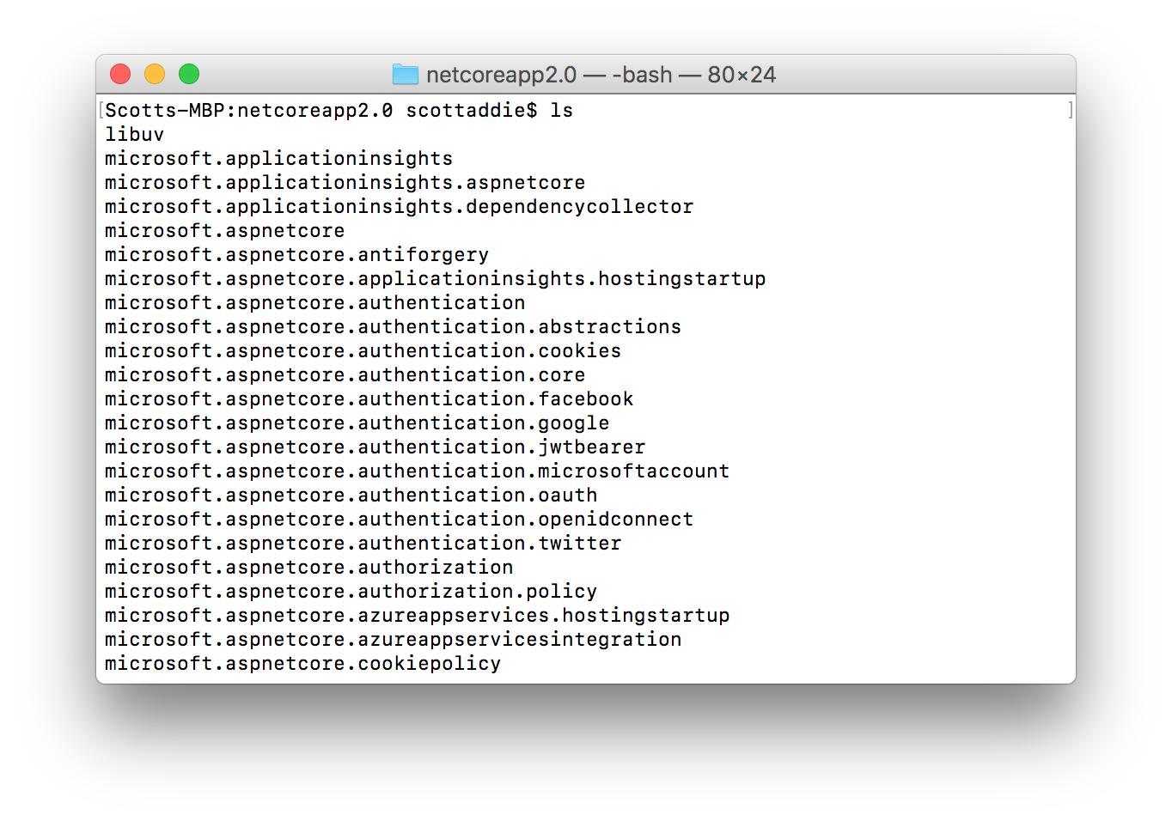
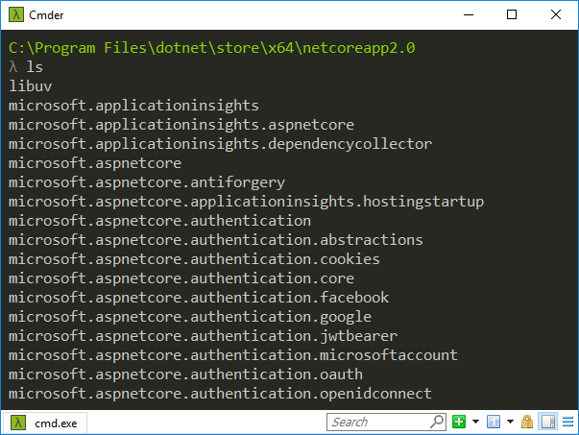
Runtime store
 | C:\Program Files\dotnet\store |  | /usr/local/share/dotnet/store
Notes:
- all EF Core & ASP.NET Core deps (incl. 3rd party)
FDD only
installed w/ .NET Core 2.0 SDK

Slide 10
DEMO
Create a custom runtime store

Slide 11
1.x WebHost / Startup recap nightmare
Program.cs
public class Program { public static void Main(string[] args) { var host = new WebHostBuilder() .UseKestrel() .UseContentRoot(Directory.GetCurrentDirectory()) .UseIISIntegration() .UseStartup<Startup>() .UseApplicationInsights() .Build(); host.Run(); } }
Startup.cs
public Startup(IHostingEnvironment env) { var builder = new ConfigurationBuilder() .SetBasePath(env.ContentRootPath) .AddJsonFile("appsettings.json", optional: false, reloadOnChange: true) .AddJsonFile($"appsettings.{env.EnvironmentName}.json", optional: true); if (env.IsDevelopment()) { builder.AddUserSecrets<Startup>(); } builder.AddEnvironmentVariables(); Configuration = builder.Build(); } public IConfigurationRoot Configuration { get; }

Slide 12
WebHost / Startup simplification
Program.cs
public class Program { public static void Main(string[] args) => BuildWebHost(args).Run(); public static IWebHost BuildWebHost(string[] args) => WebHost.CreateDefaultBuilder(args) .UseStartup<Startup>() .Build(); }
Startup.cs
public Startup(IConfiguration configuration) => Configuration = configuration; public IConfiguration Configuration { get; }
Notes:
Program.cs → CreateDefaultBuilder method handles boilerplate

Slide 13
DEMO
Add configuration providers

Slide 14
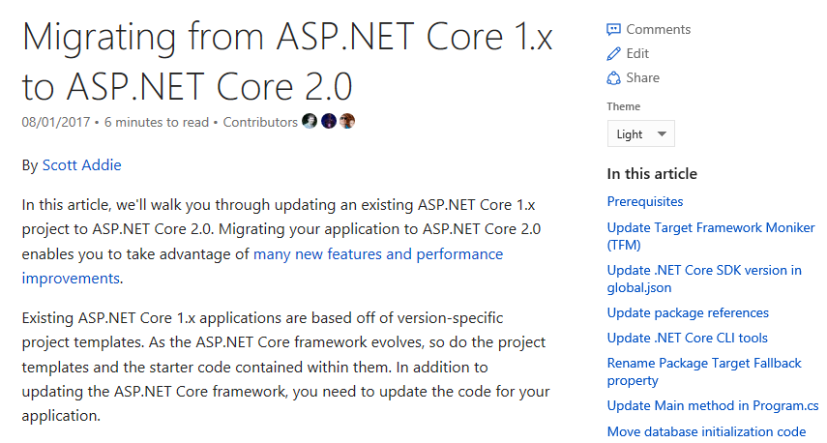
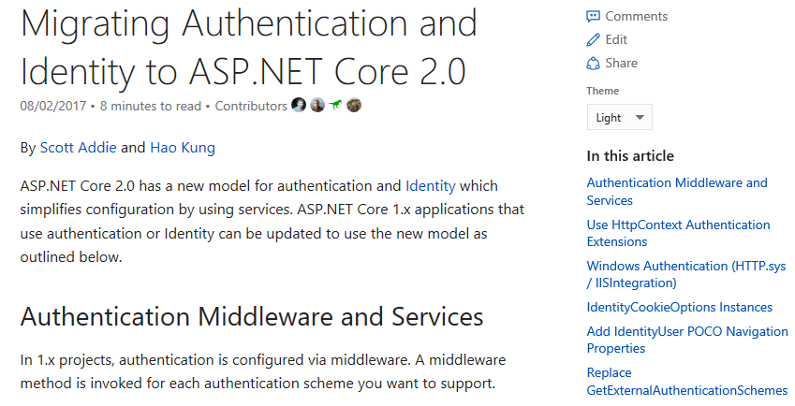

Supplementary Resources
Migration Guides
Starting point:
bit.ly/2xVMWUG
Auth / Identity:
bit.ly/2yGO9Nh
Podcast
bit.ly/2gdeJX2

Slide 15


